Slide 1
Game theory
Zach Cottrell & Caden Burrell

Slide 2
What is it?
Game Theory is a branch of mathematics that deals with the analysis and strategies behind competitive situations where the outcome of one participant’s choice is dependent upon the actions of another participant.

Slide 3
What is it used for?
Game Theory has a vast array of uses from simple games of tic-tac-toe and checkers all the way up to launching nuclear warheads.
Other fields where Game Theory is commonly used:
Economics/Finance
Automotive
Sports
Management

Slide 4
In the beginning
James Waldegrave the First Earl of Waldegrave
1684 – 1741

Slide 5
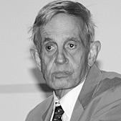
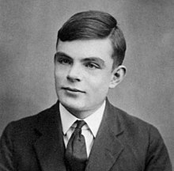
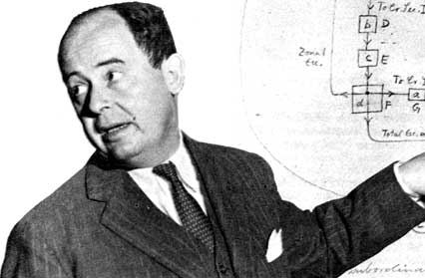
Modern breakthroughs
John von Neumann
Father of Game Theory
Alan Turing
Turing Machine
John Nash
Nash Equilibrium

