Slide 1
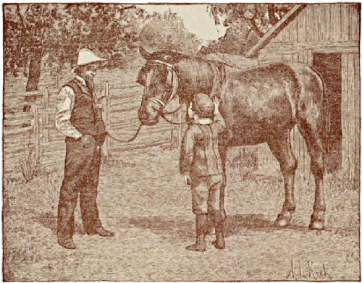
Farmer John and his horse
Farmer John needs a place to keep his horse.
Notes:
Farmer John needs a place to keep his new horse. He found a piece of land, but it doesn’t have any fences. The land looks like this…

Slide 2
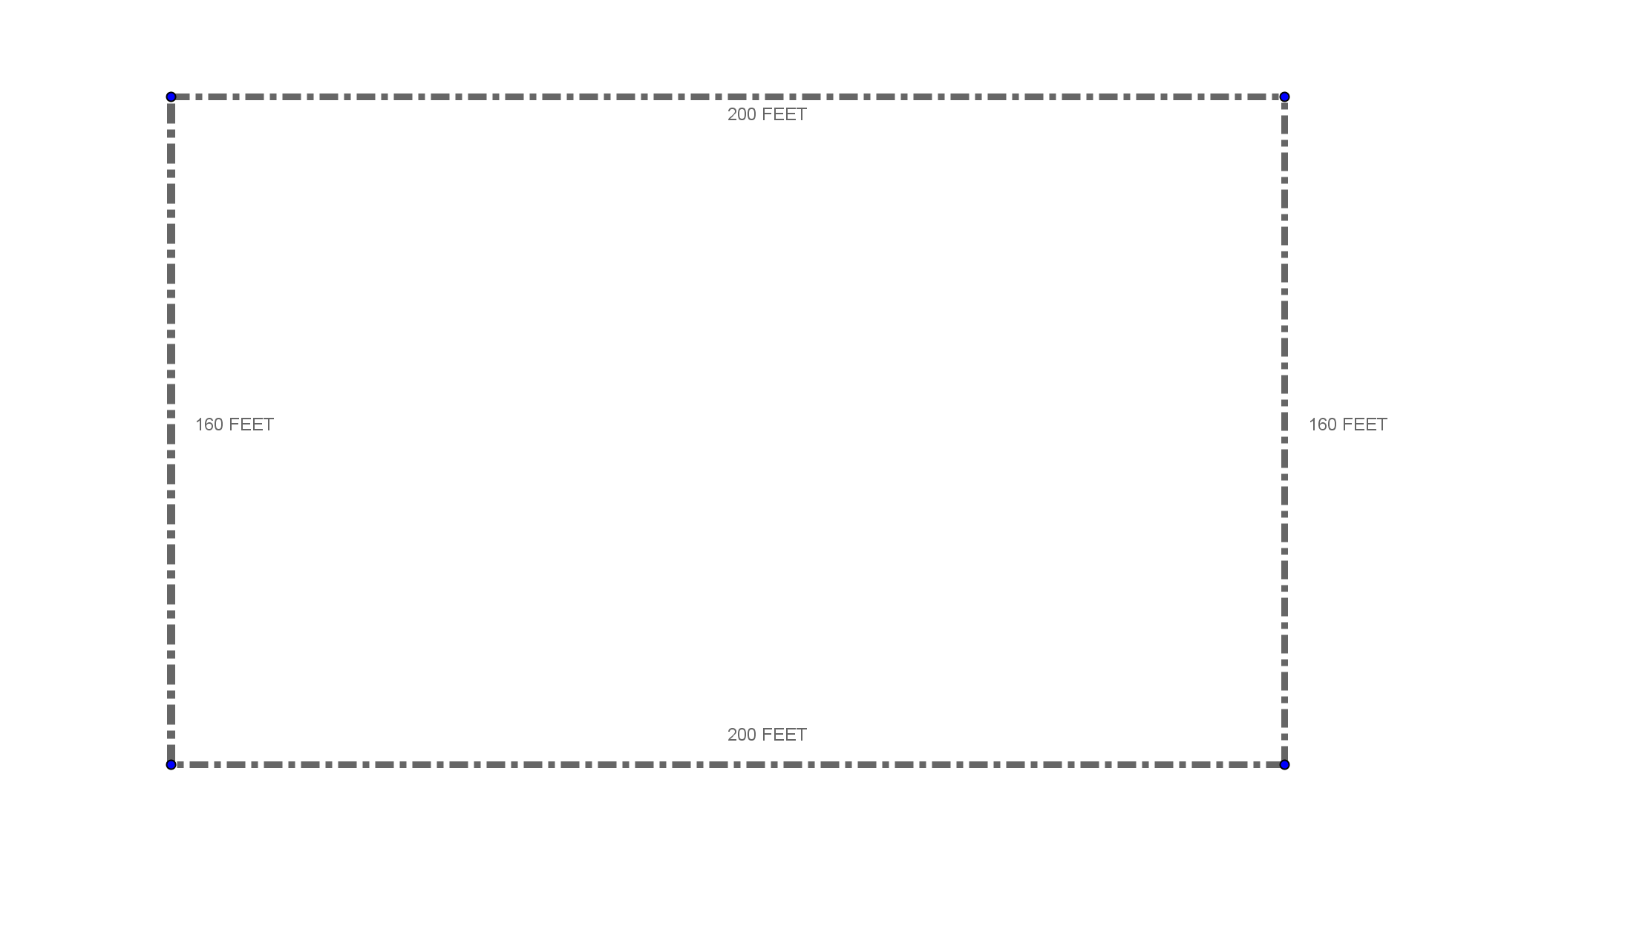
How much fence does he need?
Notes:
Someone help me figure out how much fence I need to keep Farmer John’s horse inside the property.
Ok, Sally, how do I figure out how much fence I need?
Sally either just shoots out the answer (or someone else does) and you ask again how she did this, or she actually says something like “Add it all up”.
Walk through the addition (720 feet)
Question: What is the length around the edge of a shape called?

Slide 3
Perimeter
Notes:
Yes! It’s the perimeter.
So, Sam, when I add up the lengths of all the sides of a shape, what is it called?
That’s right, the perimeter.

Slide 4
Practice Problems
1.
7 ft
2.
If Perimeter is 32 what is the length of the missing side?
4 ft
13 cm
4.
If the perimeter is 16 what is the length of the missing side?
5 m
3.
13 in
12 in
5 in
6 m
Notes:
22 ft
32 cm
30 in
16 m

Slide 5
The formula
The formula
Rectangle P = 2l + 2w
l
w
w
l
Triangle P = a + b + c
c
a
b

Slide 6
The Kingdom of Quadravia
So that his horse has enough room to exercise and graze, Farmer John wants the field to have 30,000 square feet of space.
Does Farmer John have enough land for his horse?
How do I find out?
What is this called?
Notes:
Walk them through this slide. Make sure the concept of area is covered as the multiplication of the length times the width. There may be those who don’t quite see why that is the case. The next few slides are for them.

Slide 7
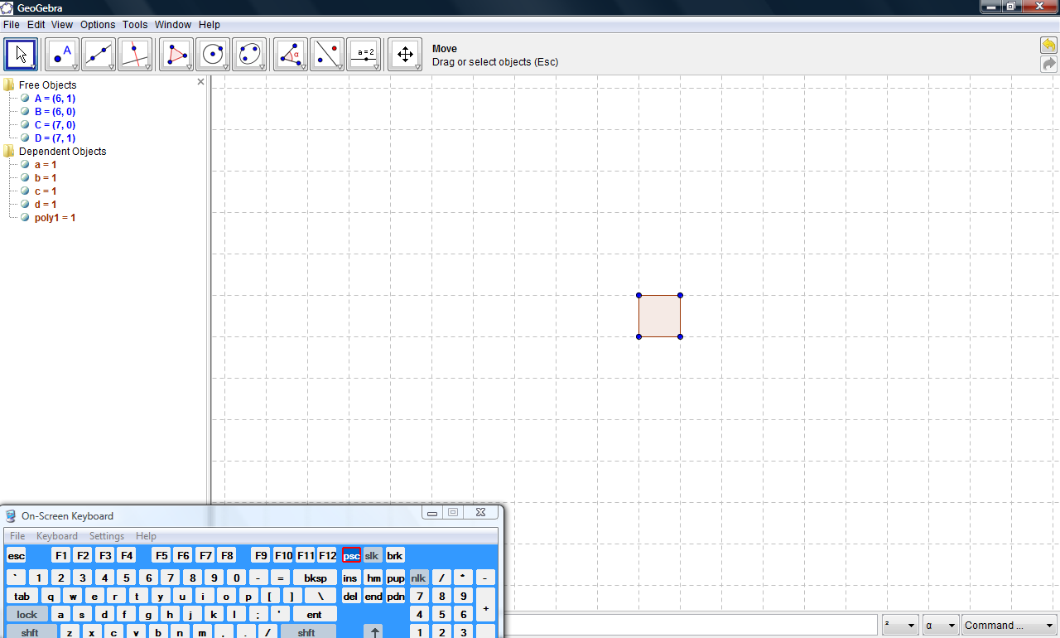
Basic Unit Field

Slide 8
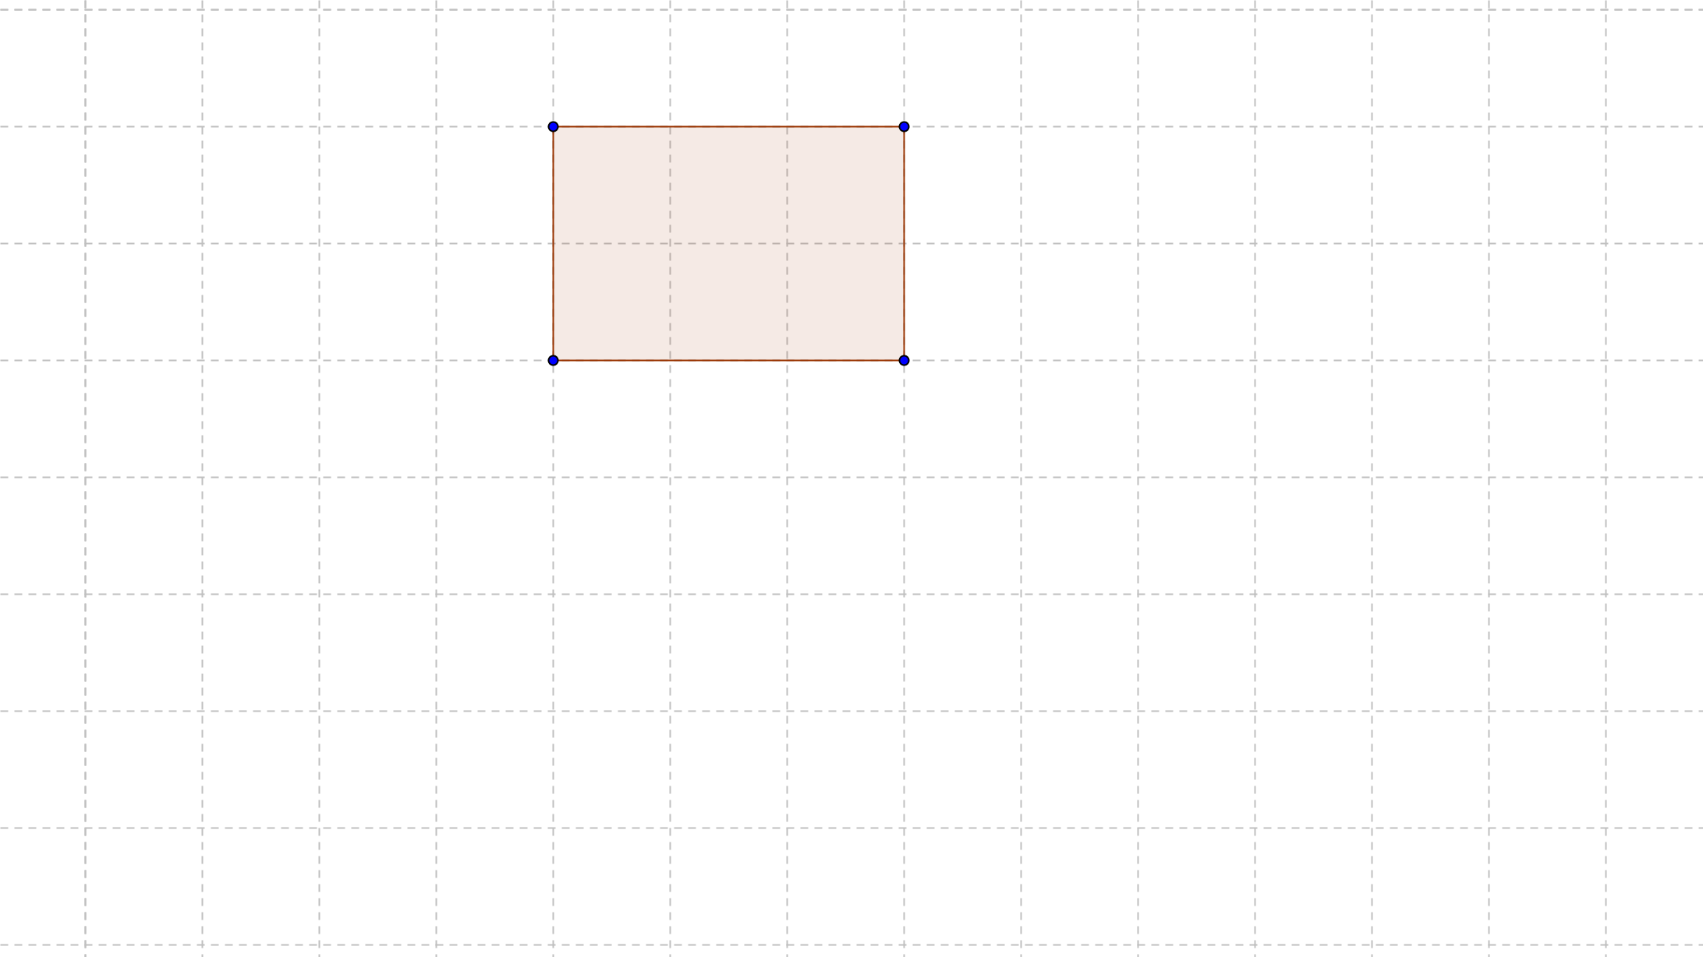
2 by 3 Field
Notes:
Let’s pretend Farmer John actually bought a mouse, and he needs just a small amount of land upon which his mouse can graze. In fact, he only needs a section this big. Can someone tell me the area of this field? How long is this field? How wide is this field? When I multiply the length(3) by the width (2), I get the area (6 square feet). It may be good to point out that multiplication is simply addition on steroids. (three two’s or two threes). Now we can count this field. What about the next one?

Slide 9
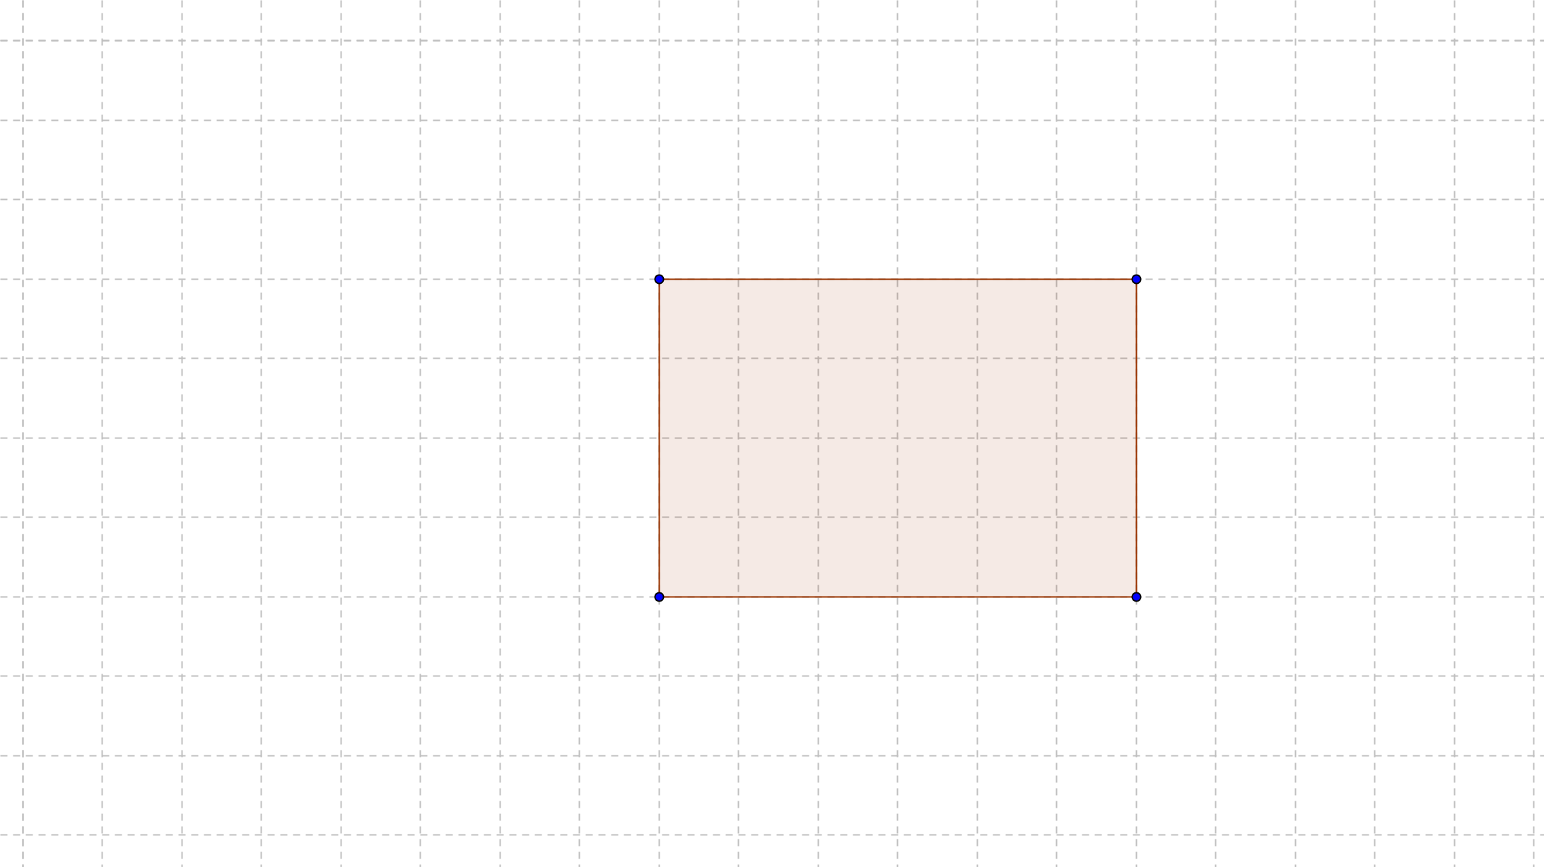
What is the area?
Notes:
We can count this one as well. However, It might be easier to just count the rows and the columns and use that knowledge and the multiplication shortcut to figure it out.

Slide 10
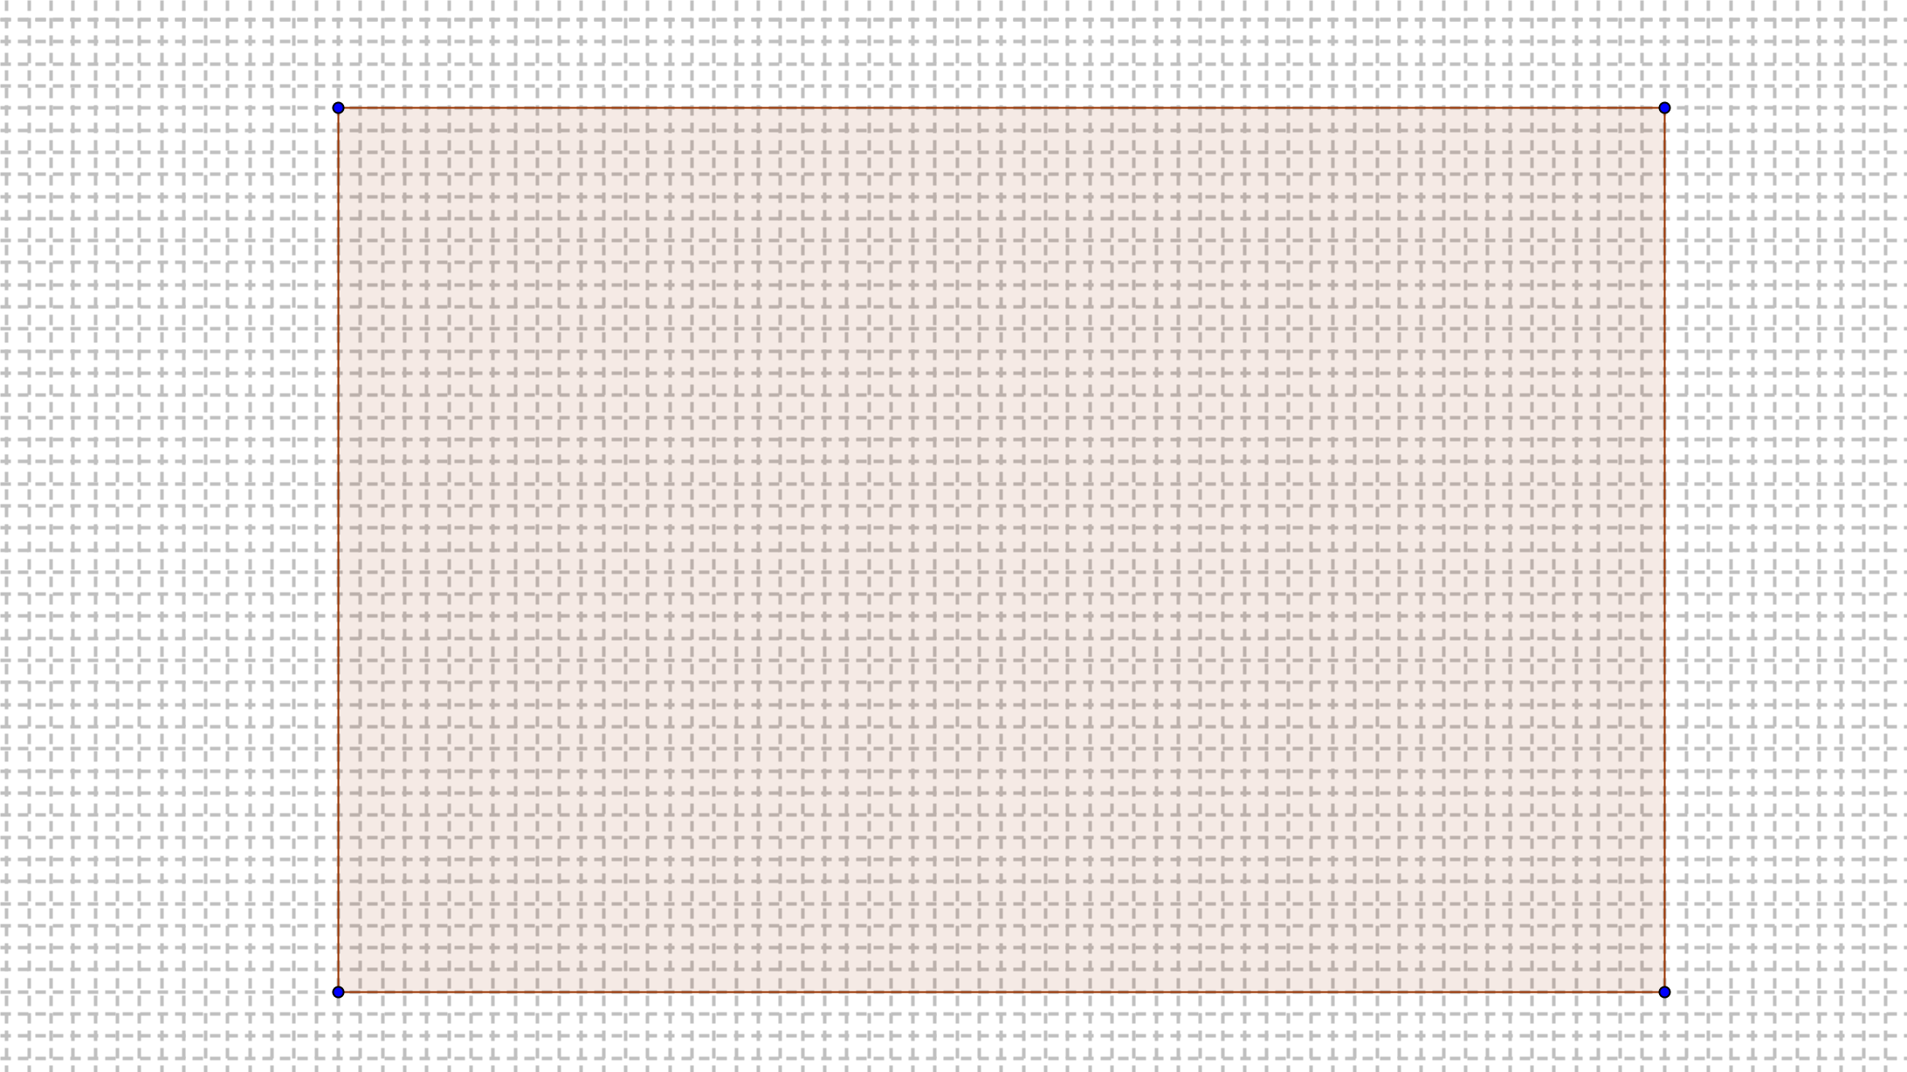
Can you count this one?
60
40
Notes:
It’s a lot harder, isn’t it, but we can still see that if I multiply the number of columns by the number of rows, I have the area.

Slide 11
Area
Notes:
That’s how I figure out the area of the field! It’s almost impossible for me to count squares with numbers this big, but if I use the numbers for the length and the width like columns and rows, I can simply multiply and it gives me the number of squares in the rectangle. Square feet, that is.

Slide 12
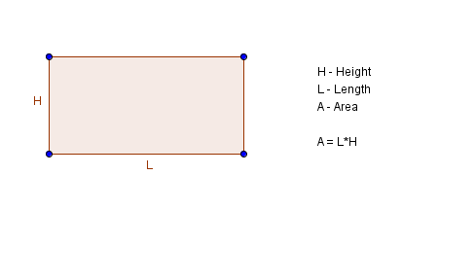
Formula for the area of a Rectangle
Notes:
The definition in the book is l * w. Do we need to be consistent with the book? I see how this helps when they are figuring out the formulas for triangles.

Slide 13
Triangles
Link to geogebra applet.
Notes:
Is this one where you will go to the geoboard…

Slide 14
Find the Area
5 in.
50 square in.
10 in.
75 square cm.
5 cm
15 cm

Slide 15
Find x
8 * x = 32
32 square ft.
8 ft.
x = 32/8
x = 4
x

Slide 16
Find x
15 square meters
(1/2) * 5 * x = 15
5 * x = 15 * 2
5 * x = 30
x
x = 30/5
x = 6
5 meters

Slide 17
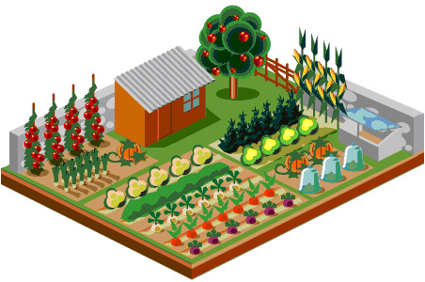
Application
You want to put fencing around the garden to keep animals out. How much fencing will you need?
If one bag of fertilizer covers 150 square feet, how many bags would you need for the garden?
22 ft
15 ft
40 ft
3. An architect designed a great room for the Martes family. The small carpeted areas are 8 foot squares. The rest of the floor is wood. What is the area in square feet of the floor that is not carpeted?
32 ft
Notes:
74 ft
Area = 330 ft² , 3 bags of fertilizer
Carpet area = 256 ft², Entire floor area = 1280 ft², wood floor area = 1024 ft²

Slide 18
Composite Figures
1.
16 cm
6 cm
10 cm
2.
3 in
11 in
18 in
Notes:
78 cm²
132 in²
18

